Slide 1
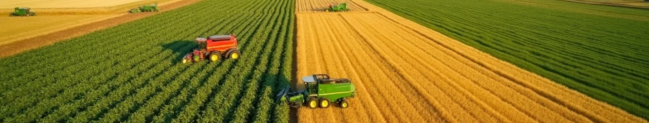


US Agricultural Land Use Analysis Report (2023)
Author: teta kevin
CODES AND IMPLEMENTATION

Slide 2

CONTENTS
1. Introduction
2. Methodology
3. results
4. recommendations
5. Future work
6.Conclusion

Slide 3


01
Introduction

Slide 4
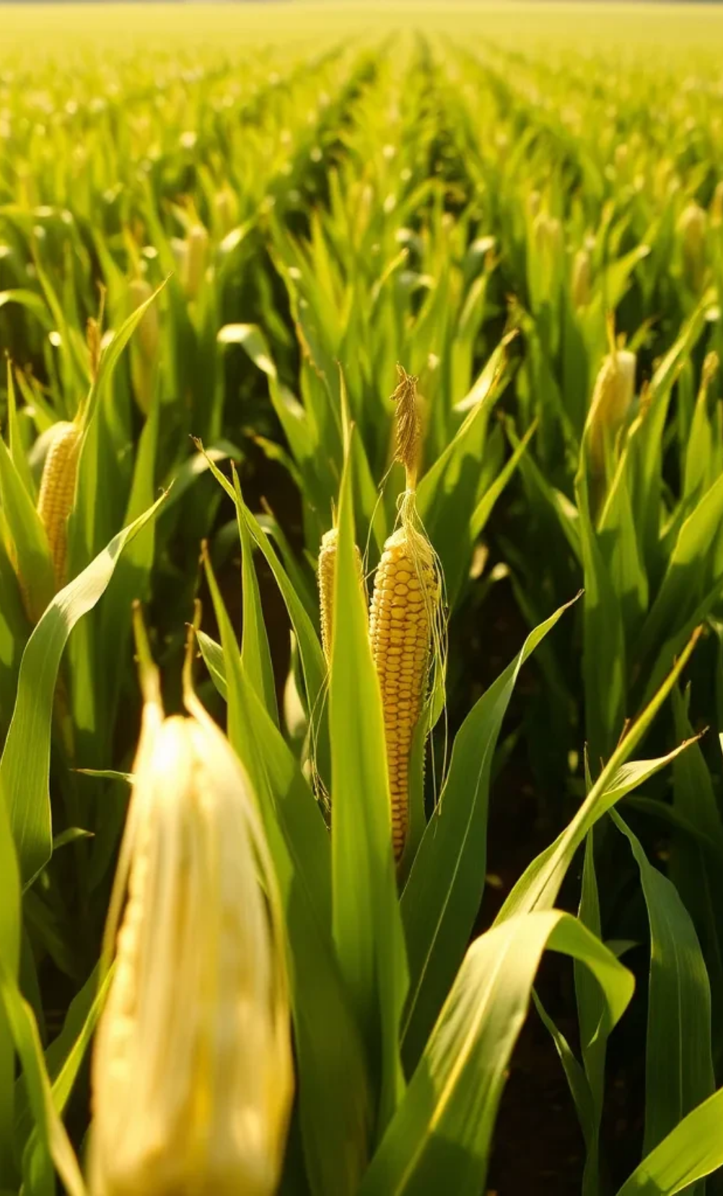

Problem Definition & Planning
1
1.1 Background
This project analyzes 2023 US crop production data from FAOSTAT
to identify patterns in agricultural land use. The goal is to help
policymakers, farmers, and agribusinesses optimize
resource allocation by understanding:
Slide 2: Project Introduction
Objective: Analyze 2023 US agriculture records to identify dominant crops and predict future cultivation trends.
Dataset: "FAOSTAT US Crop Production 2023"
Structured CSV file with over 100 rows and 14 columns.
Key columns: "crop," "area harvested," and "year".
Initial Findings: A few crops dominate a majority of the land use.

Slide 5






Dataset Identification
Dataset Title
Source Link
Rows
FAOSTAT US Crop Production 2023
FAOSTAT
100+ (one per crop type)
Columns
Structure
Status
14 (including crop, area harvested, year, etc.)
Structured CSV
Mostly clean but requires handling missing values

Slide 6

02
METHODOLOGY

Slide 7

Data Cleaning:
Handled missing values in the 'Value' column.
Converted 'Value' and 'Year' columns to numeric format.
Exploratory Data Analysis (EDA):
Univariate and Bivariate analysis to understand data distribution and relationships.
Machine Learning (Clustering):
Used K-Means Clustering to group crops by harvested area.
Determined optimal number of clusters (k=3) using the Elbow Method and
Silhouette Analysis.
Machine Learning (Supervised Learning):
Developed a Random Forest Classifier to predict crop categories
(e.g., "Small," "Medium," "Large").

Slide 8

03
RESULT

Slide 9


Introduction to EDA
EDADominant Crops
Top 10 Crops by Harvested Area:
Maize
Soybeans
Wheat
Hay & Fodder
Sorghum
Cotton
Potatoes
Sugar beets
Barley
Oats
The harvested area ('Value' column) was found to be highly right-skewed, showing that a small number of crops dominate agricultural land use.

Slide 10
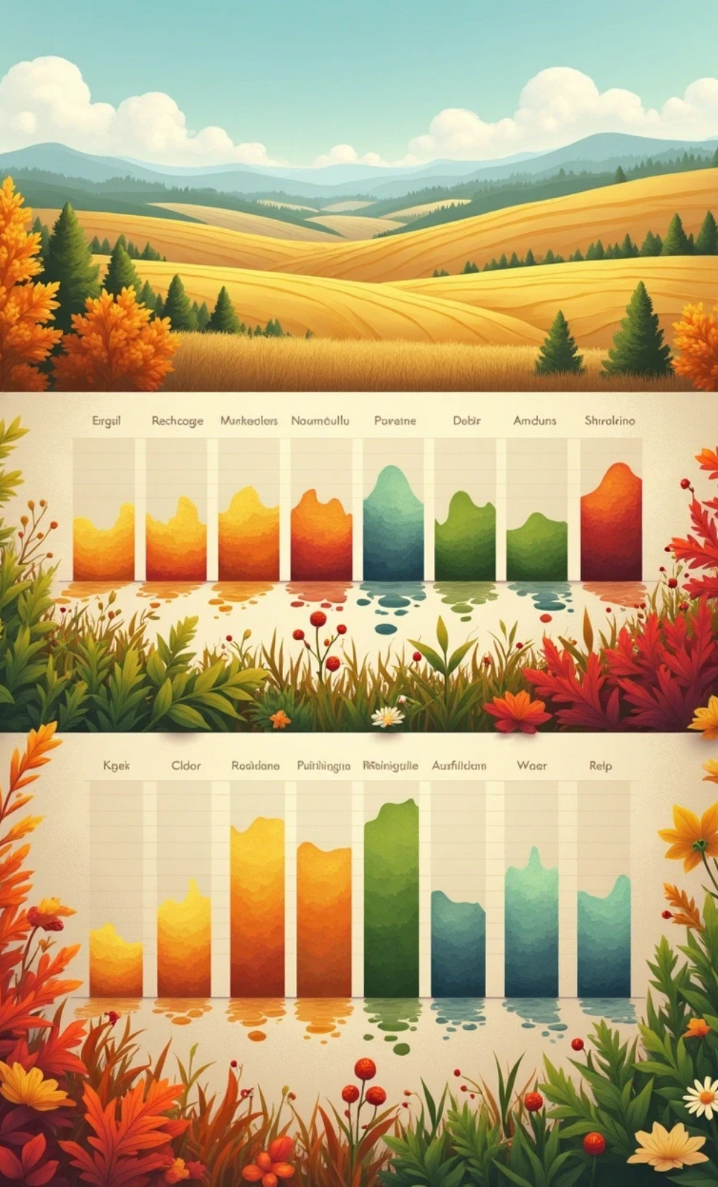
Machine Learning Model (Clustering)
1
Understanding the Goal
• Objective: Group crops into clusters based on harvested areas
2
Why Clustering?
• Discover natural groupings in crop production scale
• Identify which crops have similar land use patterns

Slide 11

K-Means Clustering
Optimal Clusters: The analysis identified three distinct clusters of crops based on their harvested area.
Cluster Descriptions:
Cluster 0 (Small): 51 crops, average area of ~23,024 ha.
Cluster 1 (Medium): 32 crops, average area of ~3,077,932 ha.
Cluster 2 (Large): 7 crops, average area of ~121 ha.
Evaluation:
Inertia: 20.75
Silhouette Score: 0.55 ("reasonable structure")

Slide 12

Predictive Model
Objective: Predict crop categories ("Small", "Medium", "Large") based on harvested area.
Model: Random Forest Classifier.
Performance:
Accuracy: 1.00 on the test set.
Outperformed Logistic Regression (0.22 accuracy).
Explainable AI (SHAP): Confirmed that higher harvested area directly correlates with a crop being classified as "Large."

Slide 13

Key Observations
1
Shape
2
K-Means Clustering
Number of rows and columns
The analysis identified three distinct clusters
of crops based on their harvested area.
3
EDA & Dominant Crops
4
Predictive Model
Analysing dominant crops per hectare
Predict crop categories ("Small", "Medium", "Large")
based on harvested area.

Slide 14


Key Insights
Skewness
Outliers
Right-skewed (few crops dominate land use)
Some crops have extremely large areas (e.g., maize, soybeans)

Slide 15

04
RECOMMENDATION

Slide 16
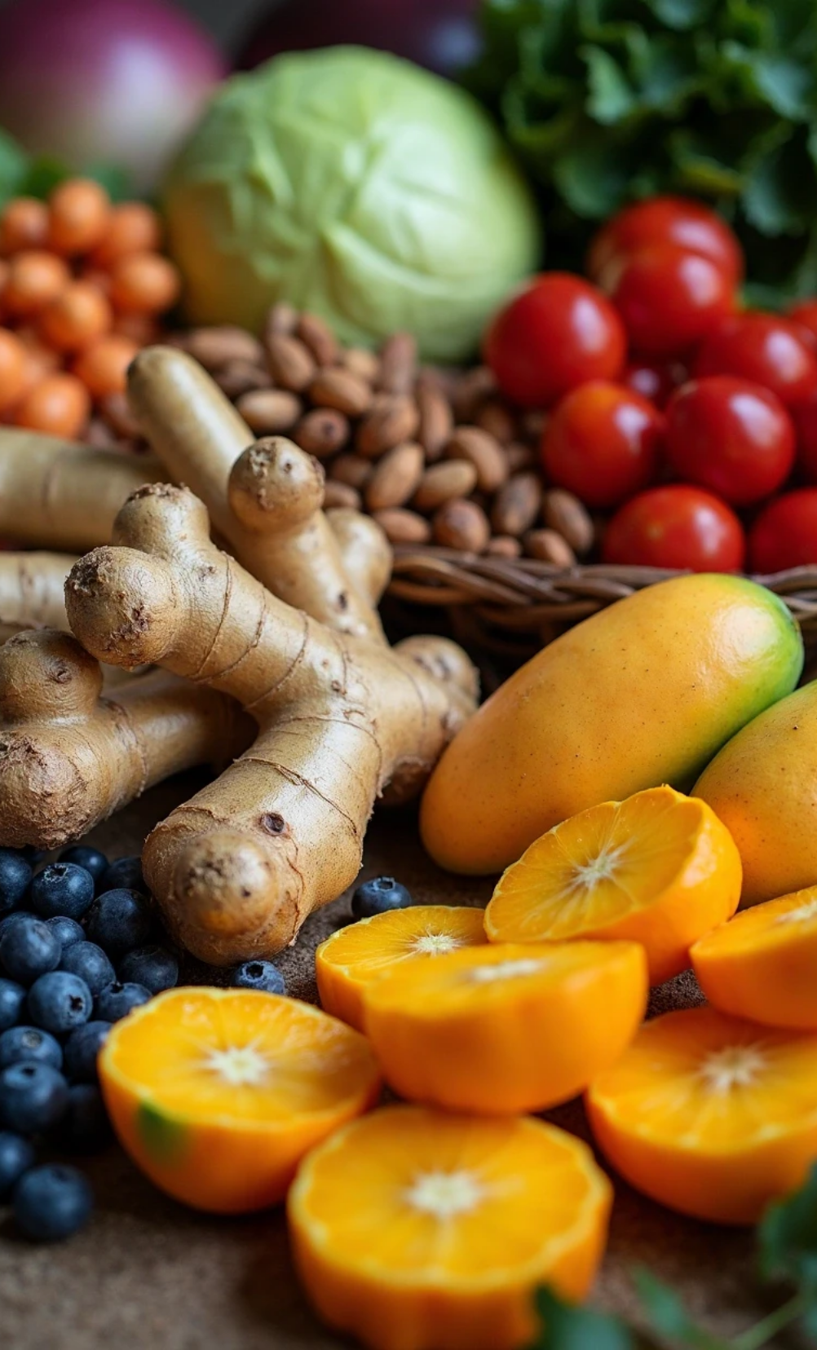
For "Large" Crops (e.g., Maize, Soybeans): Focus on policies that improve efficiency, such as better irrigation techniques or subsidies.
For "Small" Crops (e.g., specialty crops): Promote high-value markets like organic or local produce to maximize profitability per hectare.
Data-Driven Planning: Utilize the predictive model to automate the classification of new crops and support informed agricultural policy decisions.

Slide 17

05
FUTURE WORK

Slide 18
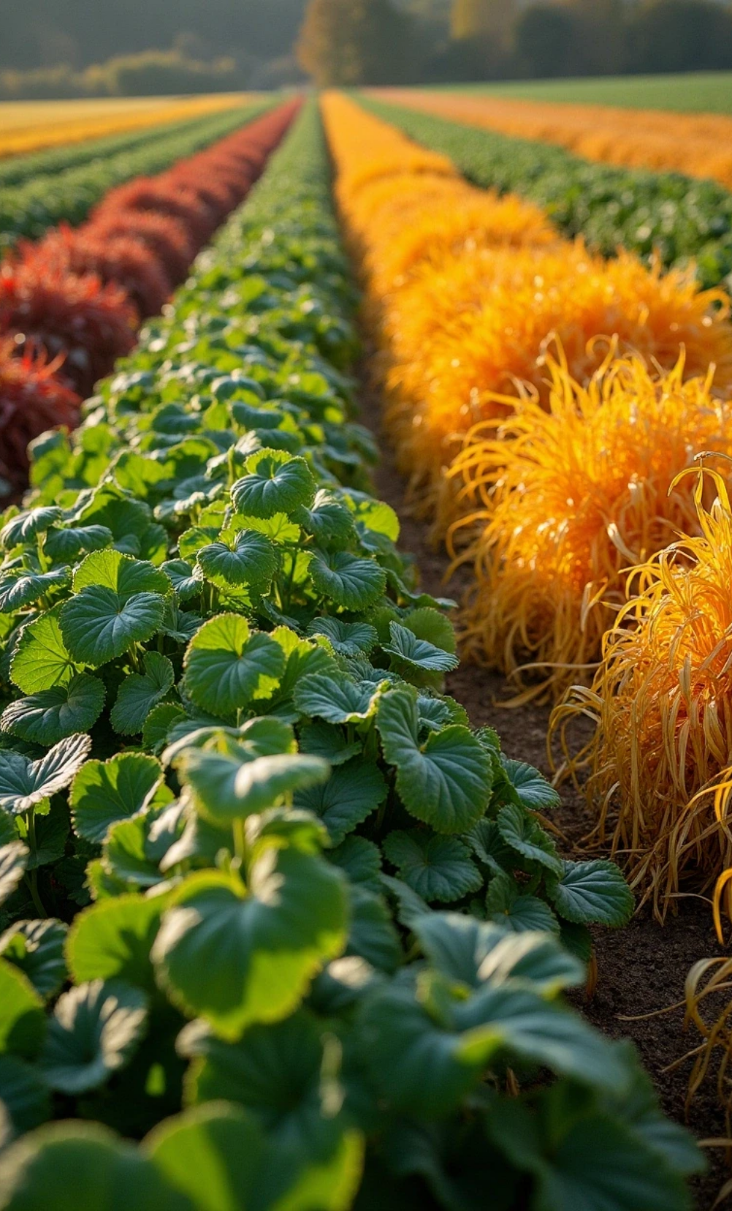
Incorporate Additional Data:
Weather patterns
Commodity prices
Soil quality metrics
Advanced Modeling:
Time-series forecasting for crop demand.
Yield prediction using satellite imagery.
Dashboard Enhancements:
Real-time data integration.
Interactive "what-if" scenarios for policy planning

Slide 19
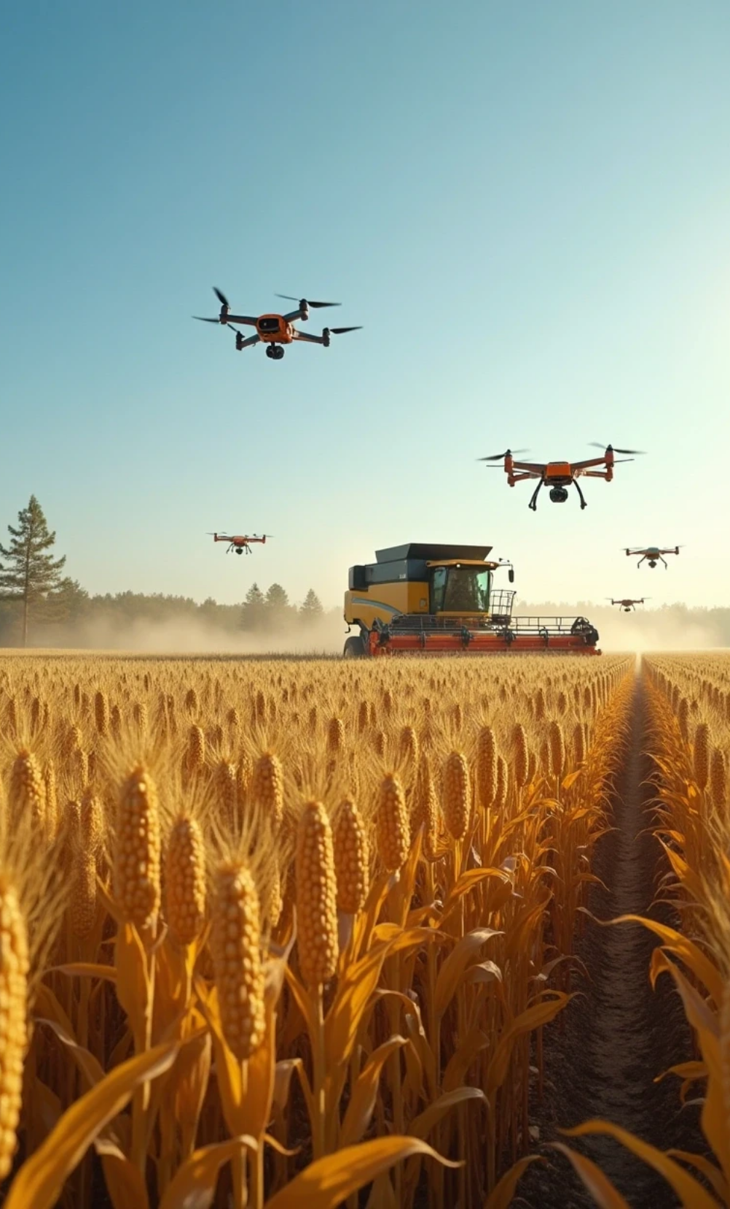
Conclusion
This analysis provides a data-driven foundation for optimizing US agricultural land use. By combining clustering, classification, and visualization, we’ve identified actionable insights to balance productivity and sustainability.

Slide 20

Thank You

